Slide 1

A Website for Tuition Centre Group Name: Lucas

Slide 2




Group Members
 | Member 1 | Member 2 | Member 3 | Member 4
Name | Pang Chin Wei | Tham Ying Han | Toh Yan Xian | Lee Jian Zhen
Student ID | 20ACB01232 | 20ACB01170 | 19ACB03356 | 19ACB02281
Practical Group | P16 | P16 | P16 | P16

Slide 3
Introduction

Slide 4
Introduction
Background Study:
Past: No websites for tuition centre
Now: Several tuition websites, used to share useful information
Target Audience
Students and their parents
Admin of the Tuition Centre
Problem Description
Go to the tuition centre for every process(registration, get info and many more)
With website every process can be done through the internet.

Slide 5
Introduction
Benefits to the users
Students and Parents
Connect with the tuition centre (communicate with the tuition centre)
Get important updates and info
Admins of tuition centre
Get messages and registration data

Slide 6
Literature Review

Slide 7
Website 1: Catalyst EDU

Slide 8
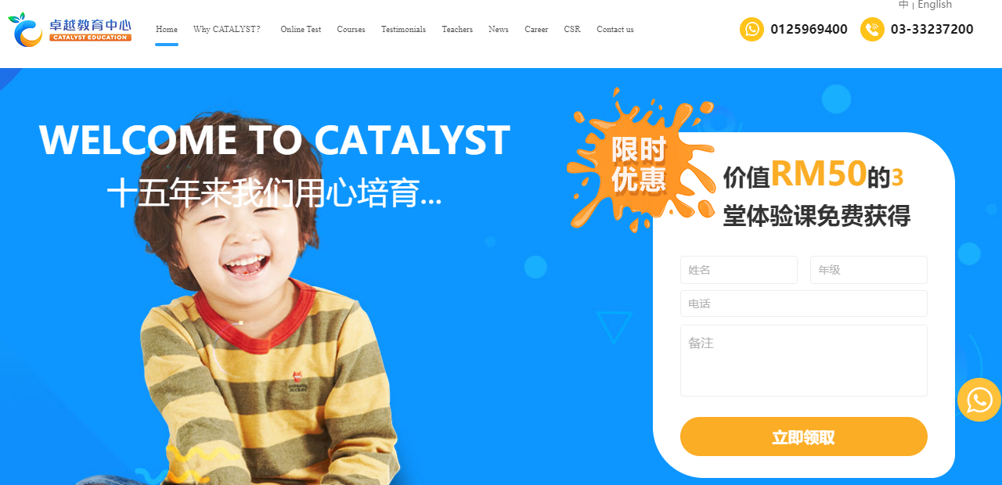
Advantage 1: Bilingual

Slide 9
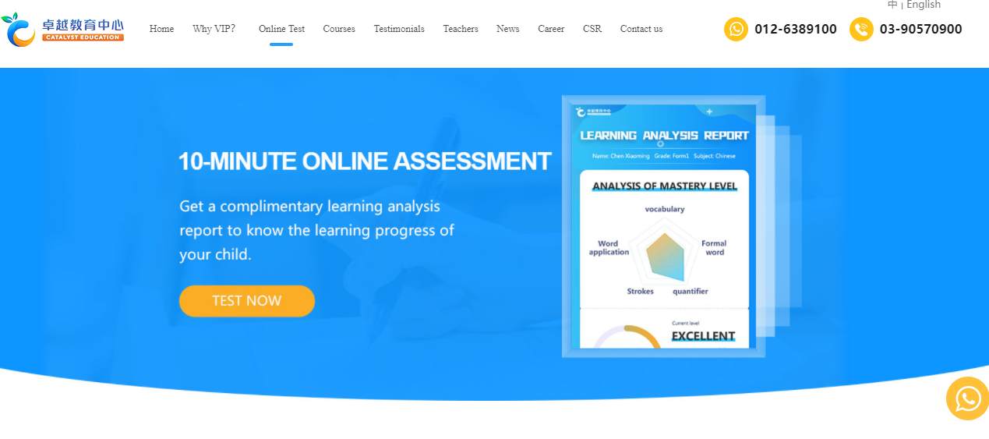
Advantage 2: Online Test

Slide 10

Advantage 3: Back-to-top button

Slide 11
Disadvantage 1: No timetable Disadvantage 2: Small text on navigation bar

Slide 12
Limitation: Lack of shop feature
Recommendation: Add timetable feature

Slide 13
Website 2: AI Tuition

Slide 14
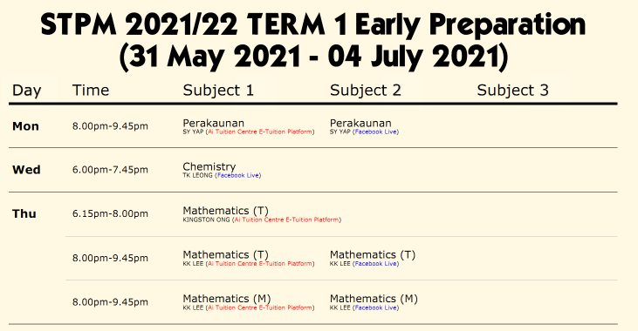
Advantage 1: Class Schedule List

Slide 15
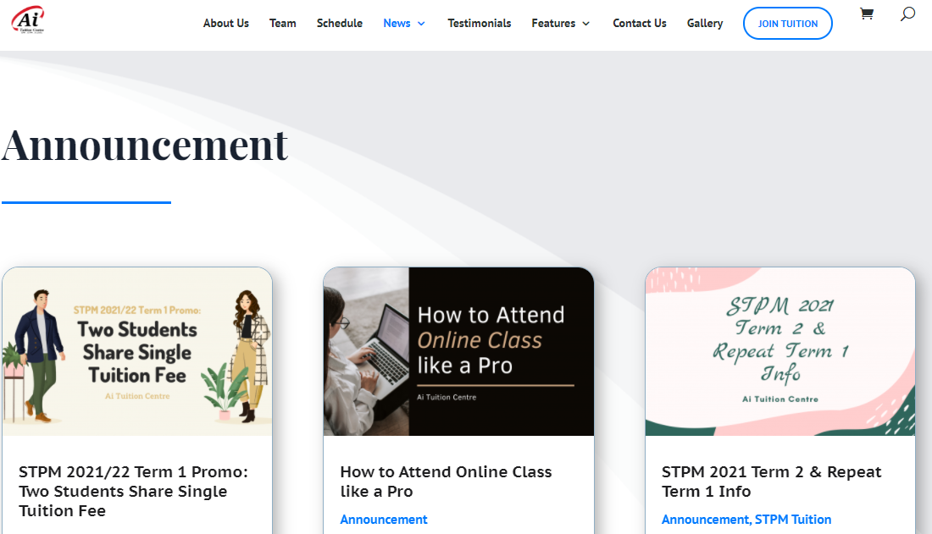
Advantage 2: Announcement Page

Slide 16
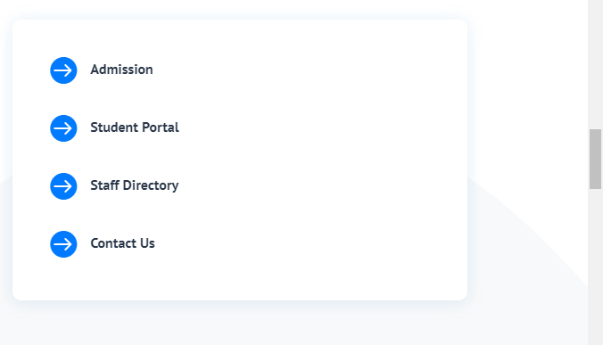
Disadvantage 1: No text when hover above icon Disadvantage 2: Important links located in the middle of About Us page

Slide 17
Limitation: No separate navigation bar for important links
Recommendation:
Add separate navigation bar for important links

Slide 18
Website 3: VBest

Slide 19
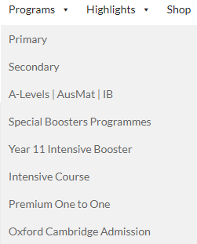
Advantage 1: Programs sorted neatly in single element of navigation bar

Slide 20
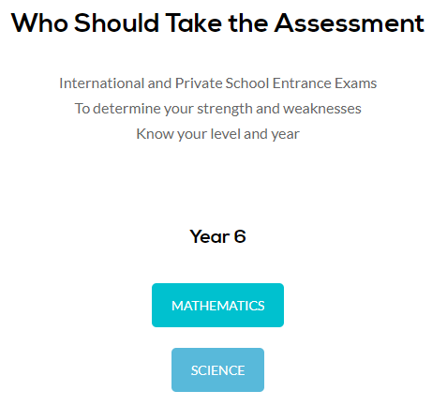
Advantage 2: Online Assessment

Slide 21
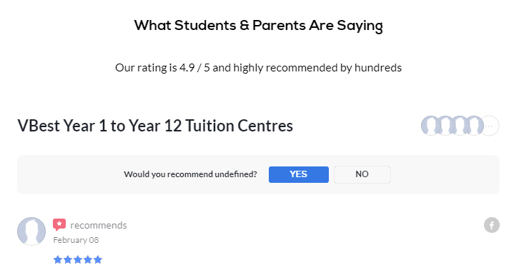
Advantage 3: Rating and Review Feature

Slide 22

Disadvantage 1: Lengthy paragraphs that bores the user Disadvantage 2: Day and time of class not shown

Slide 23
Limitation: User unable to register class on website
Recommendation: Add timetable feature

Slide 24
Advantages of Our Website

Slide 25
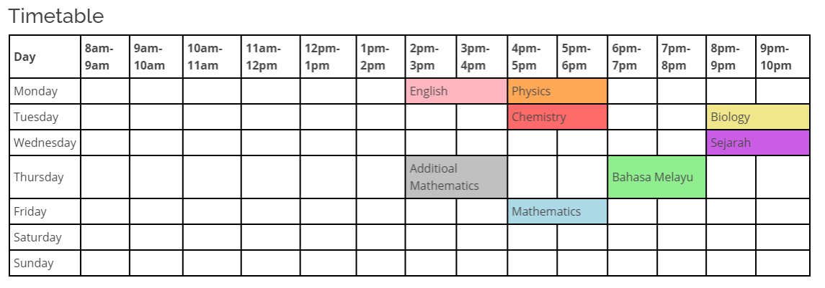
Advantage 1: Timetable Feature

Slide 26
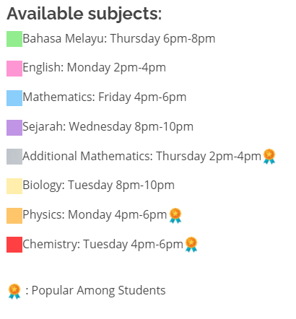
Advantage 2: Shows popular classes among students

Slide 27
Technologies Used
Firebase
FormBackend

Slide 28
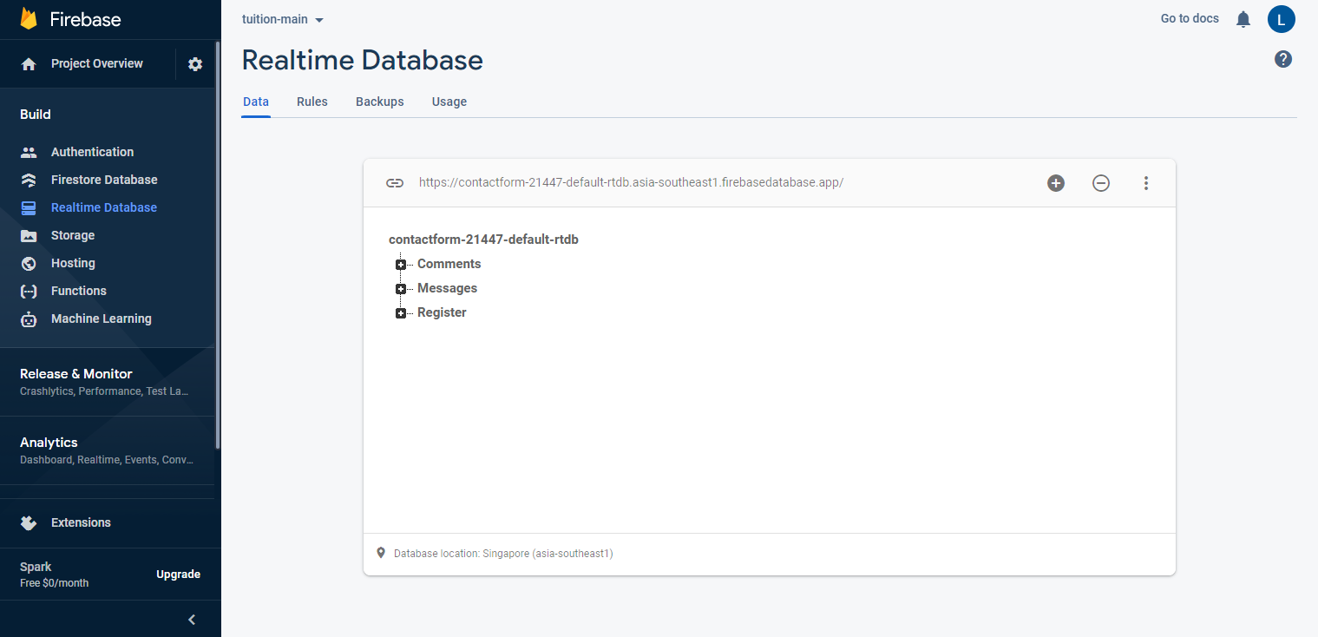
Firebase
Store comments.
Store messages asked by user.
Store registration form.

Slide 29
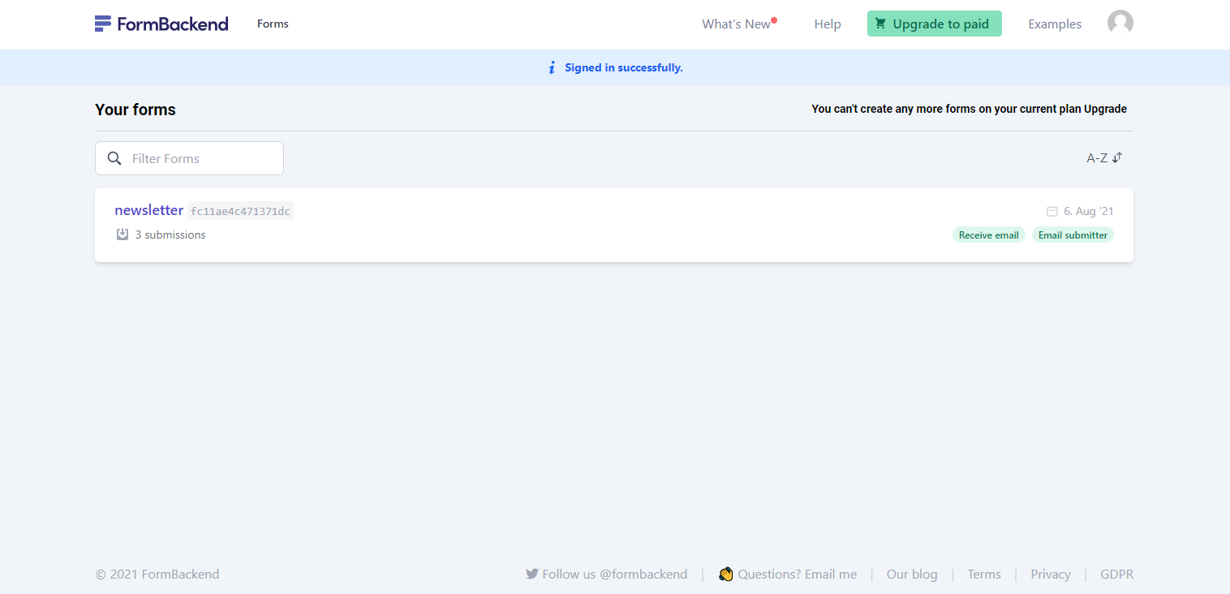
Formbackend
Store subscription email
Send newest update to those emails

Slide 30
Design

Slide 31
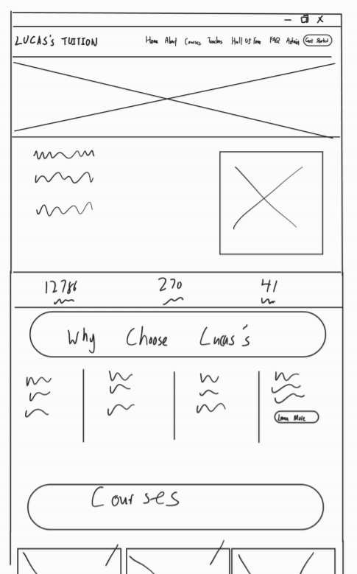
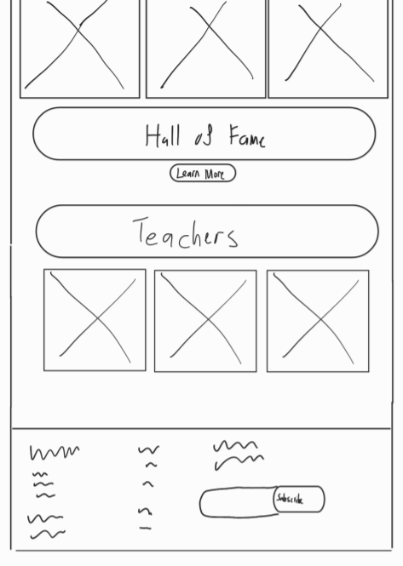
WireFrame-index.html

Slide 32
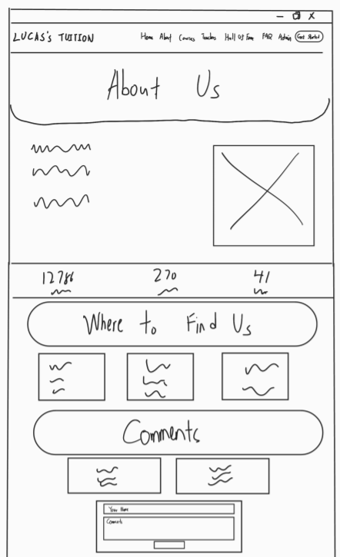

WireFrame-about.html

Slide 33
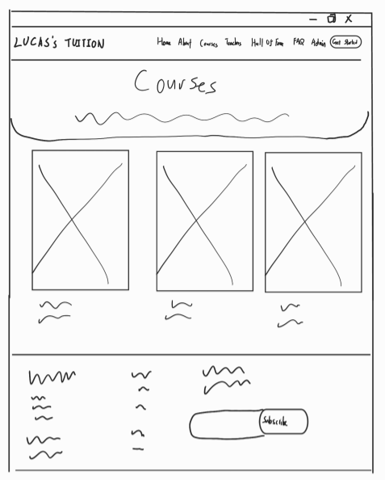
WireFrame-courses.html

Slide 34
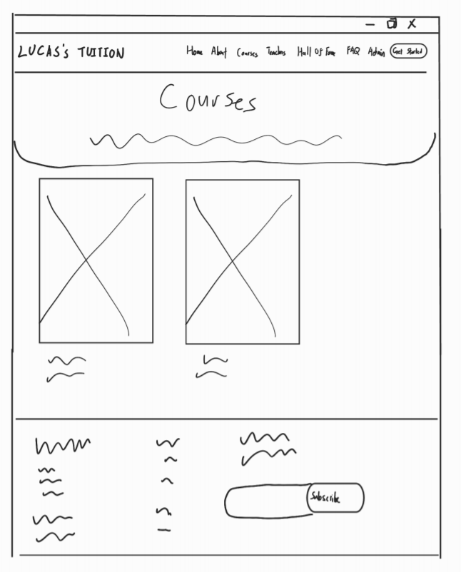
WireFrame-courses-details-xxx.html
*xxx stands for SPM, STPM and UEC

Slide 35
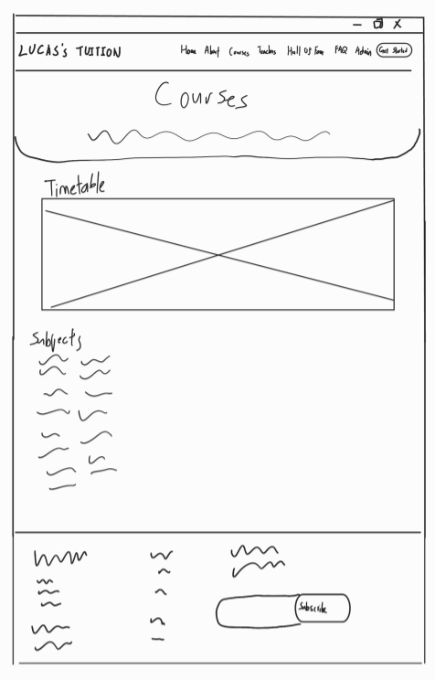
WireFrame-courses-details-xxx-yyy.html
*xxx stands for SPM, STPM and UEC
*yyy stands for Science and Commerce

Slide 36
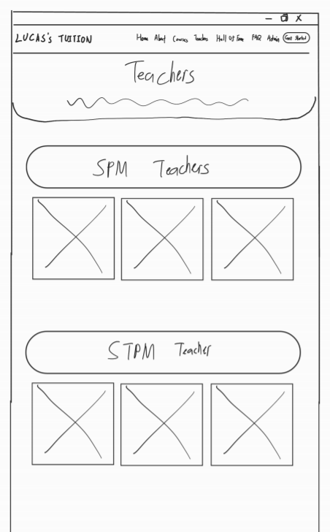
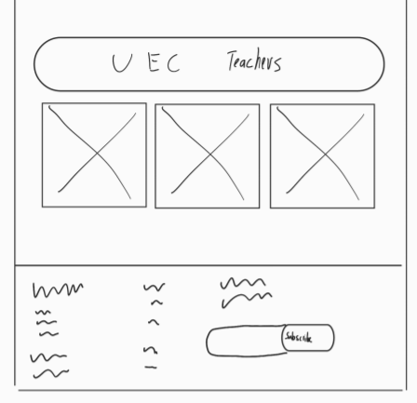
WireFrame-trainers.html

Slide 37
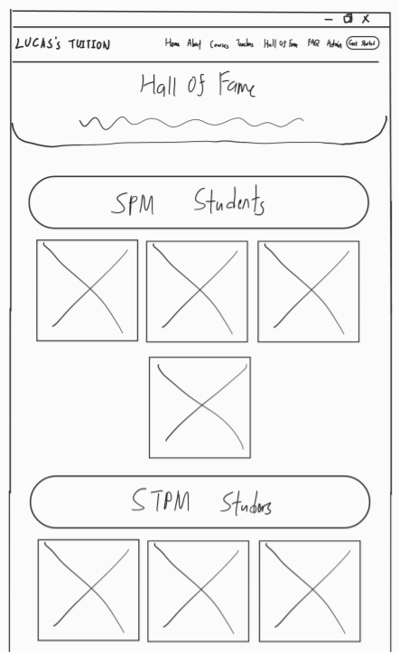
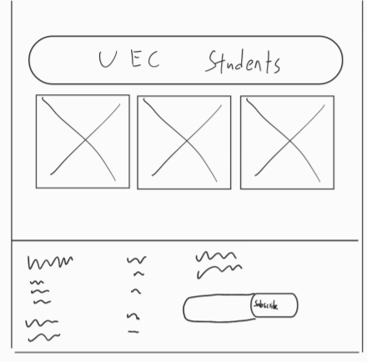
WireFrame-halloffame.html

Slide 38
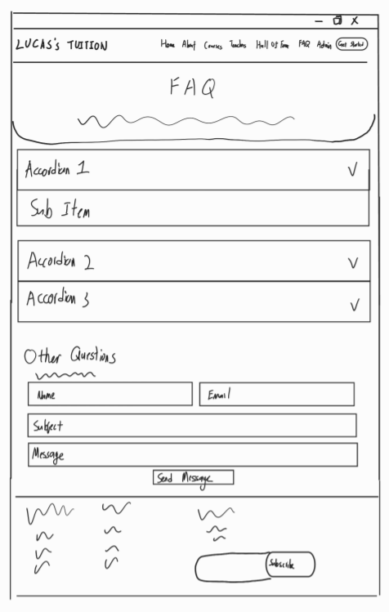
WireFrame-faq.html

Slide 39
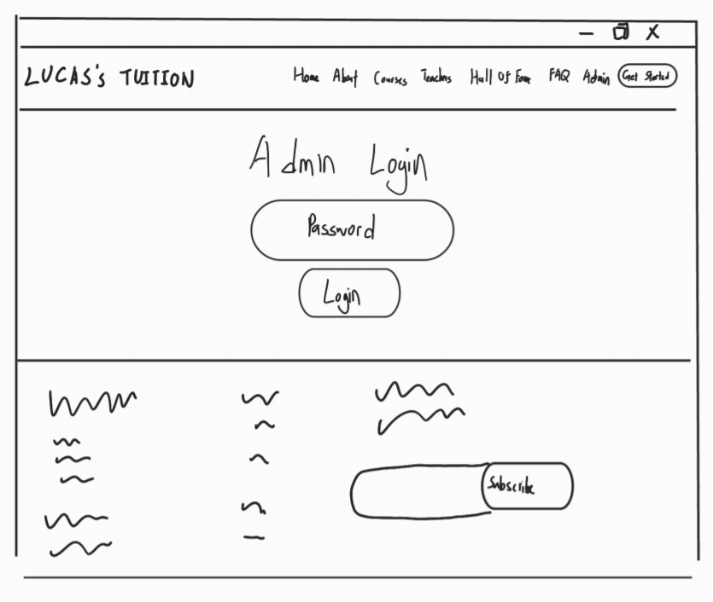
WireFrame-adminlogin.html

Slide 40
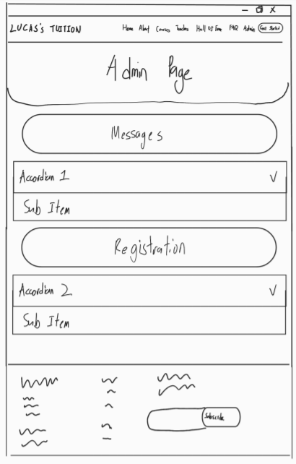
WireFrame-admin.html

Slide 41
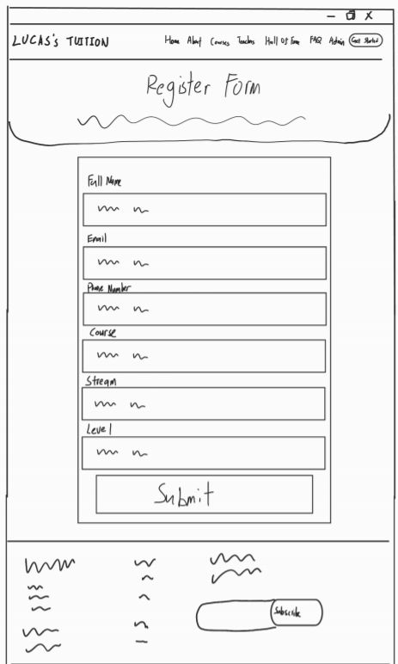
WireFrame-register.html

Slide 42
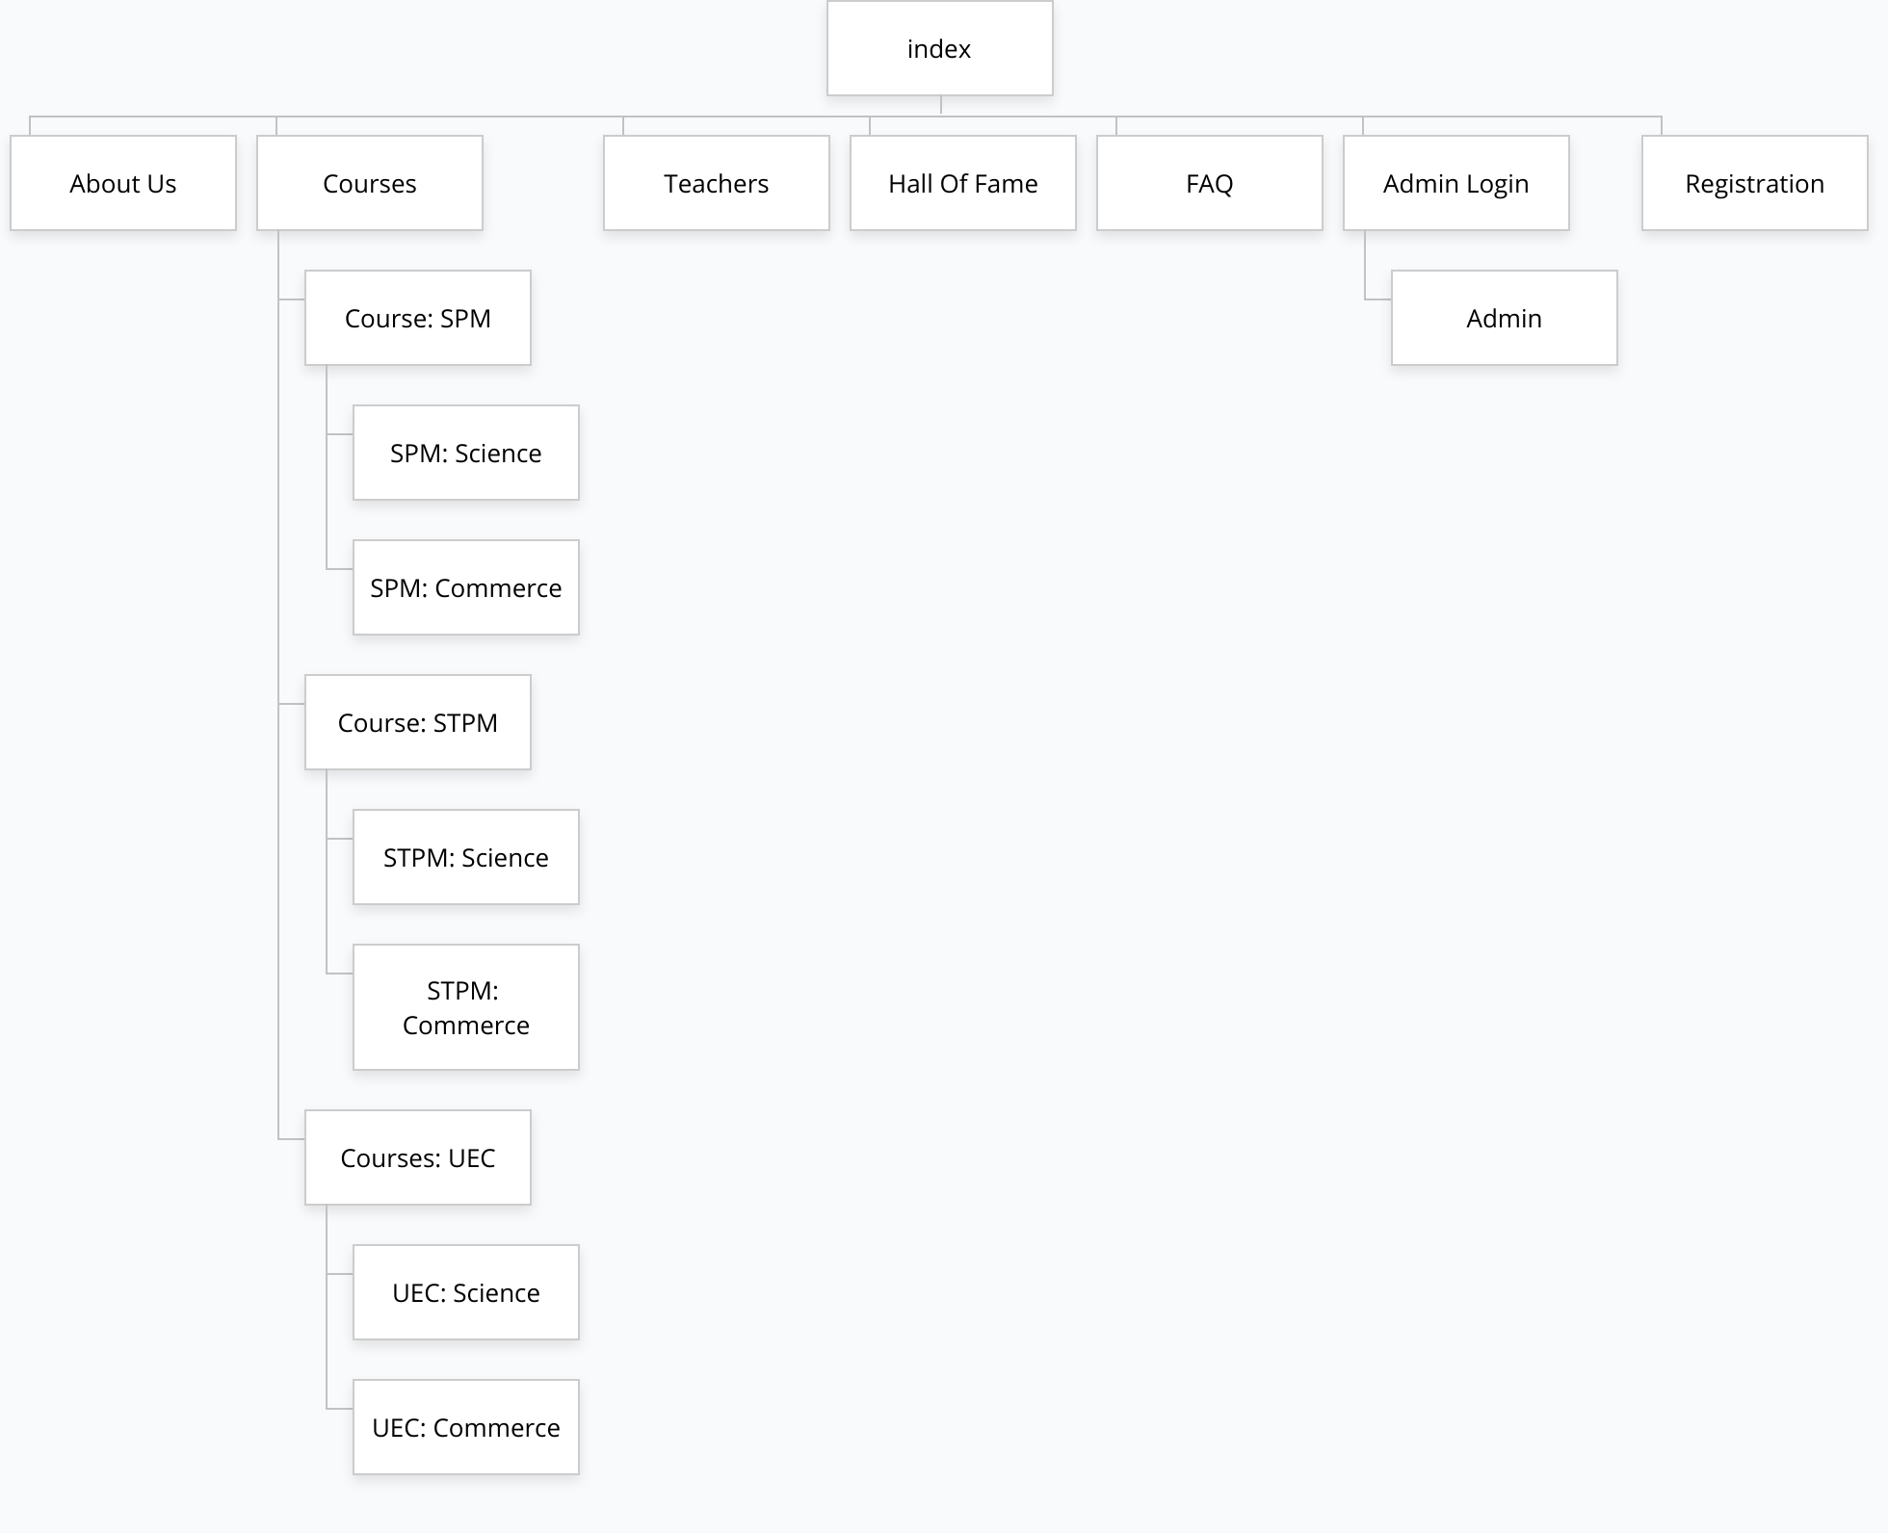
Site Map

Slide 43
Website Functionalities (Tham Ying Han)
Session Storage
(Index)

Slide 44
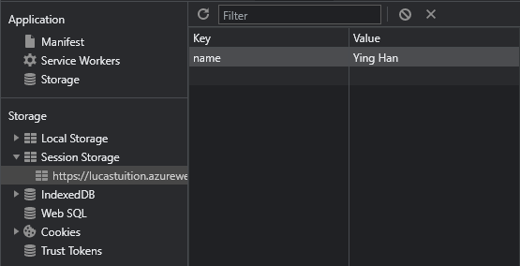
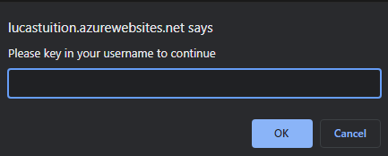
User will be prompt to input a name when accessing website, the inputted name will be saved in session storage.

Slide 45

The index page will get the name from the session storage,
then output it in the index page

Slide 46
Website Functionalities (Tham Ying Han)
Notifications
(main)

Slide 47

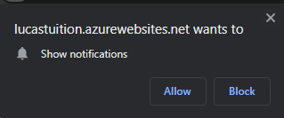
User will be prompt whether to allow or block notifications when accessing the website for the first time.
This is how the notification looks like

Slide 48
Website Functionalities (Tham Ying Han)
PWA

Slide 49
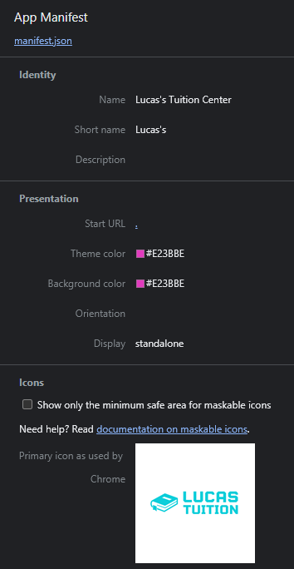
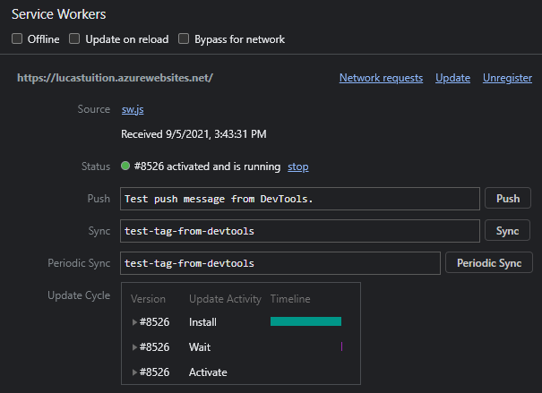
To turn our website into a progressive web app,
Manifest and Service Worker has been implemented.

Slide 50
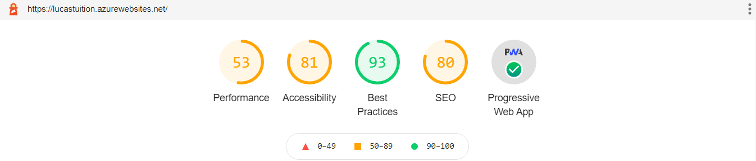
This lighthouse report shows that our website is installable and PWA Optimised

Slide 51
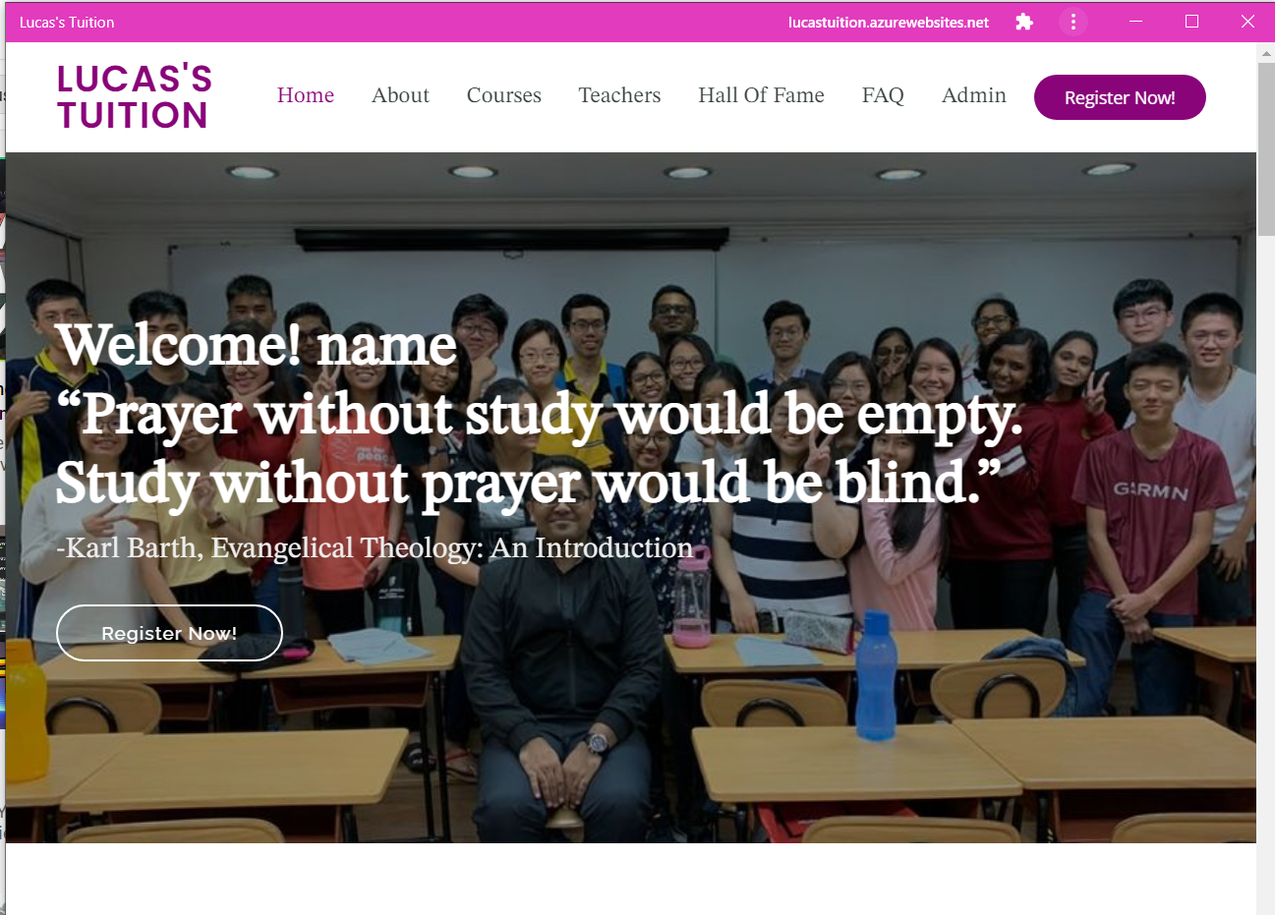
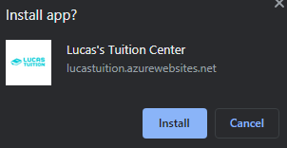
This is how the installed PWA looks like

Slide 52
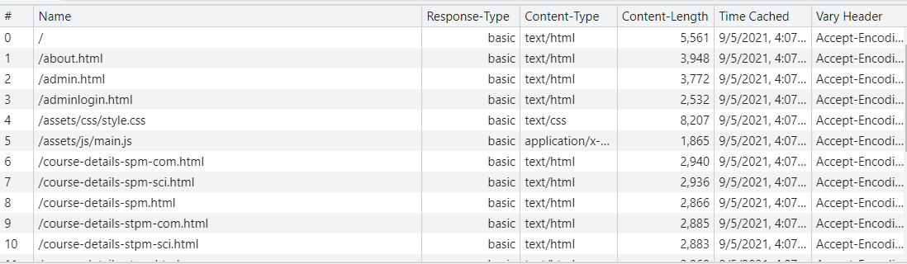
Service Worker is also used to cache our website to make over website available offline

Slide 53
Website Functionalities (Lee Jian Zhen)
Database Write

Slide 54
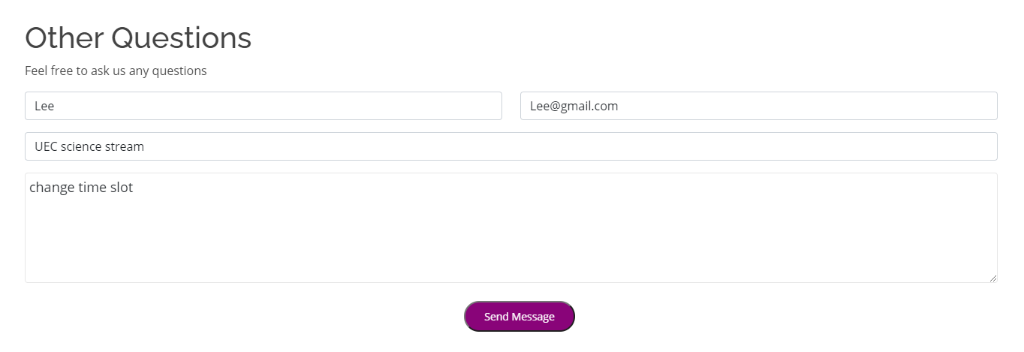
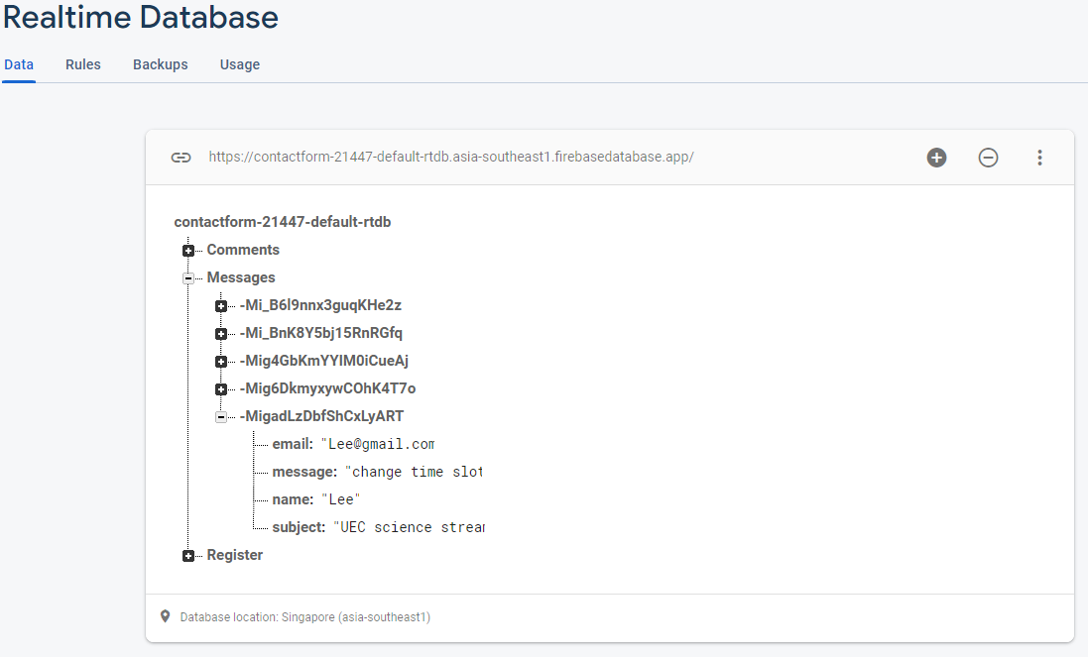
Store question asked inside Firebase

Slide 55
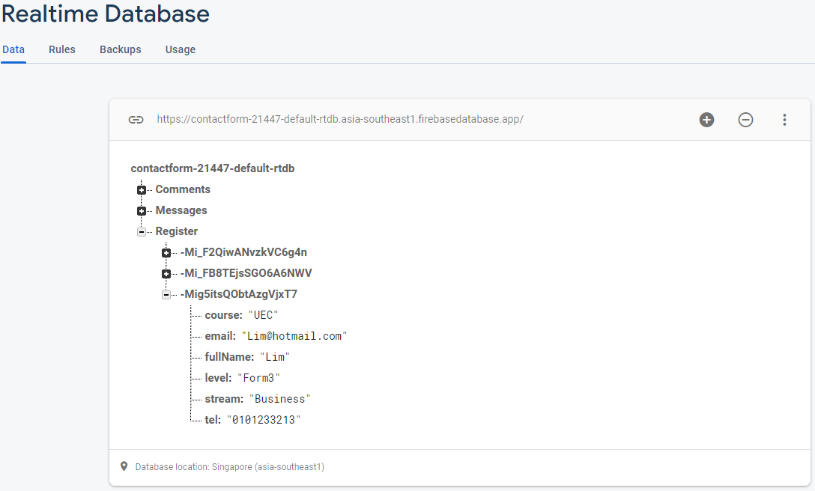
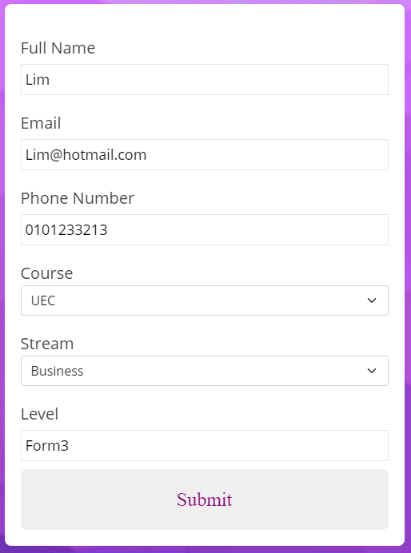
Store registration information inside Firebase

Slide 56
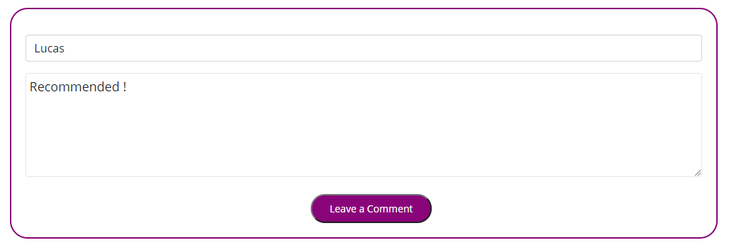
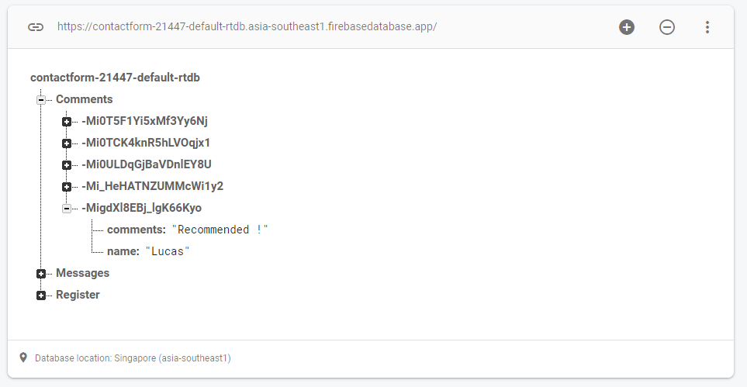
Store comments from user inside Firebase

Slide 57
Website Functionalities (Lee Jian Zhen)
Registration Notification

Slide 58

Pop up message while successfully registered

Slide 59
Website Functionalities (Pang Chin Wei)
Database Read

Slide 60
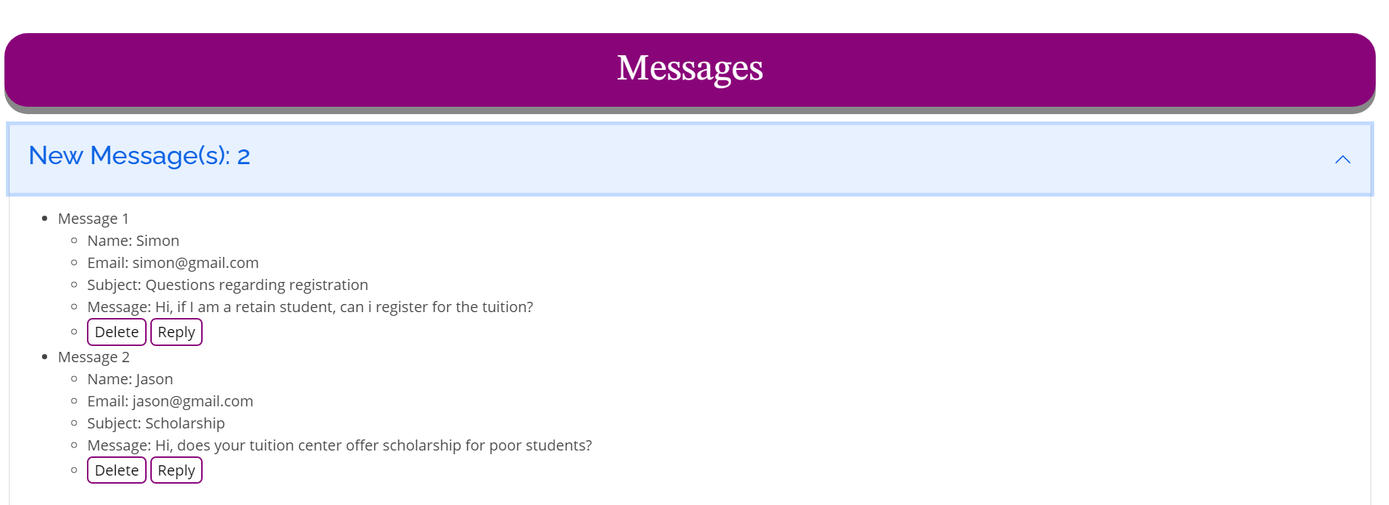
Admin Page (Message Section)

Slide 61
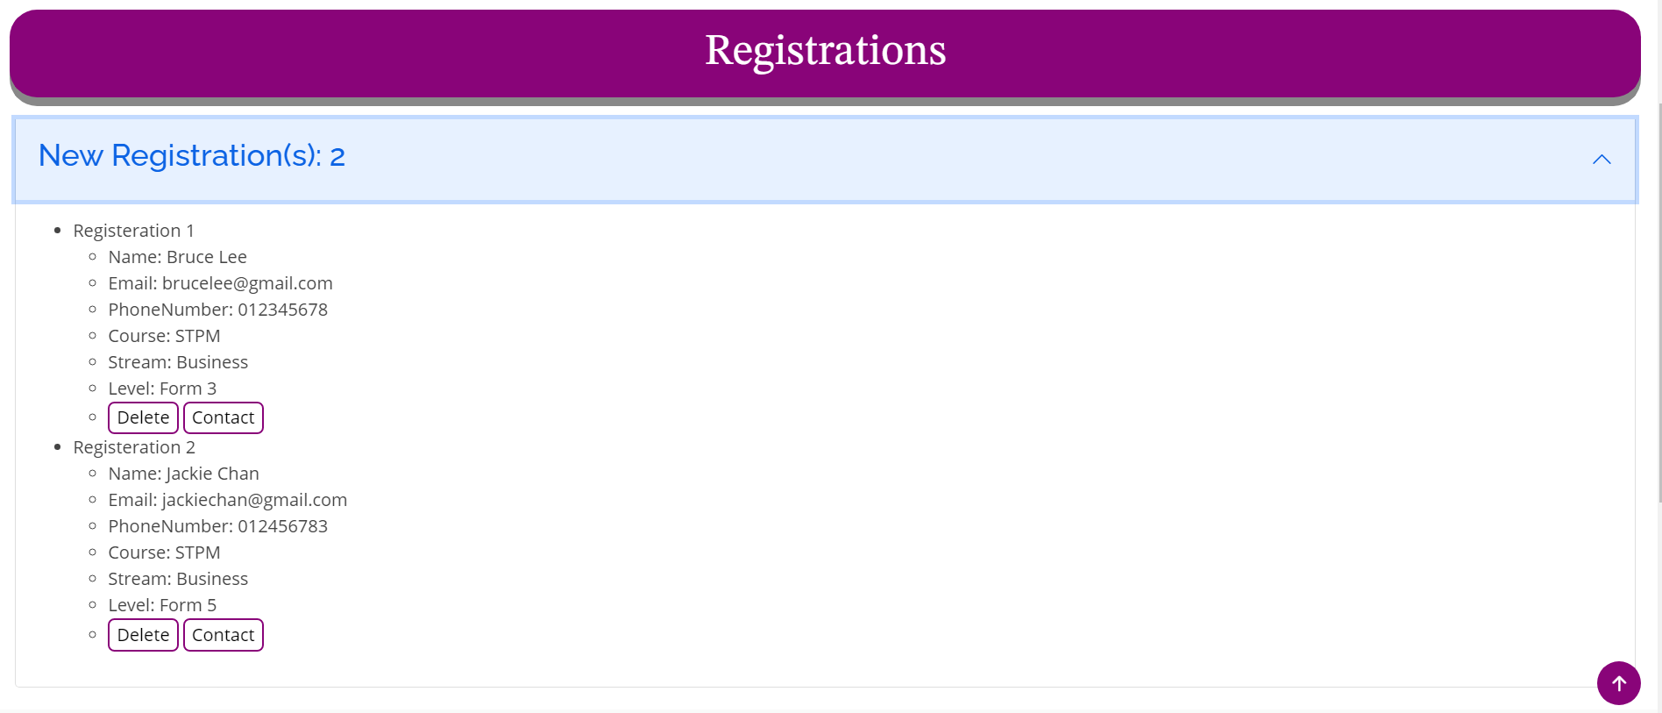
Admin Page (Registration Section)

Slide 62
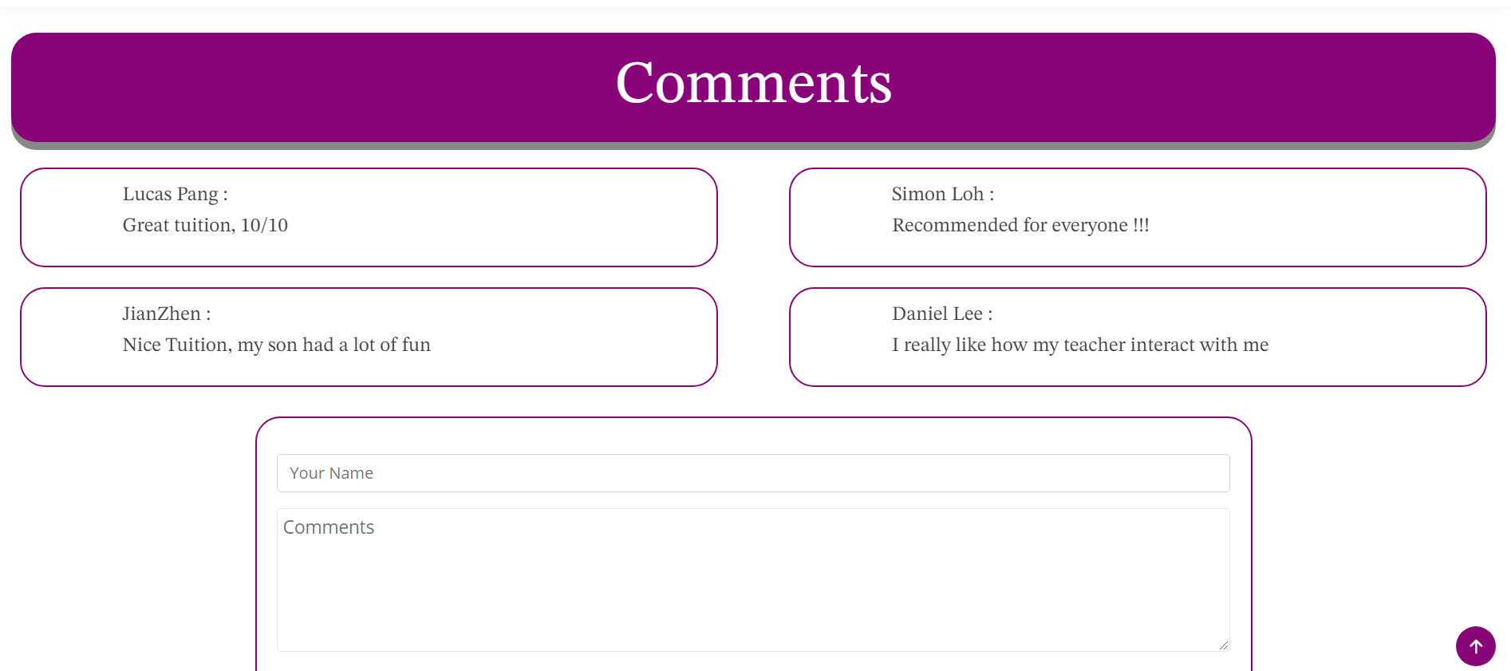
Comments Section

Slide 63
Website Functionalities (Pang Chin Wei)
FAQ Notifications

Slide 64
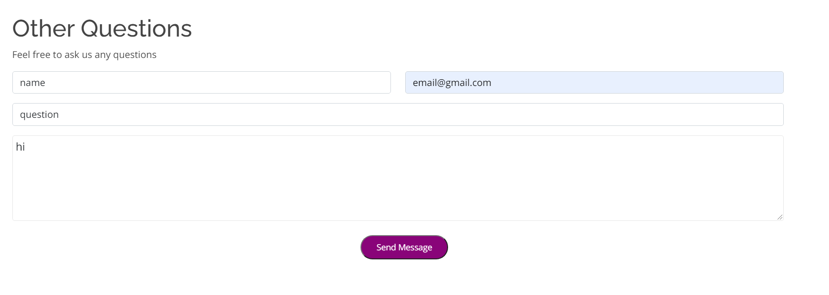

FAQ Form
FAQ Notification

Slide 65
Website Functionalities (Toh Yan Xian)
Session Storage
(Login Page)

Slide 66

When login to admin page, system will ask user to key in password

Slide 67


When user keys in correct password, session storage will store 1 and allow user to access admin page
When user keys in wrong password, an error message will pop up

Slide 68

If user tries to go to admin page by typing URL, error message will pop up as 1 is not found in session storage

Slide 69
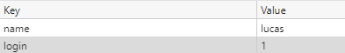
Session storage when user keys in correct password

Slide 70
Website Functionalities (Toh Yan Xian)
Subscription

Slide 71
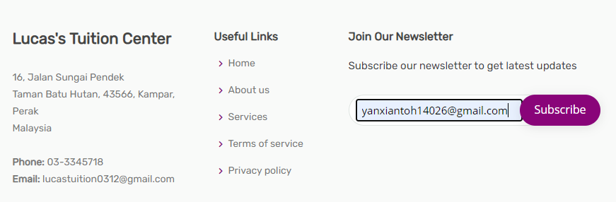
User can subscribe to the website so that they will receive notifications on update

Slide 72
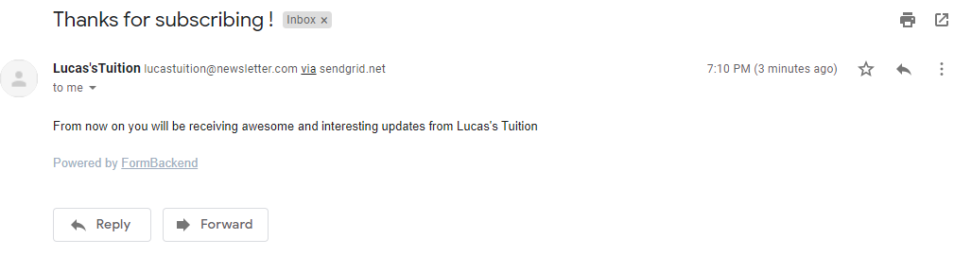
The user will then receive this email and their email will also be stored for future use (share updates).

Slide 73
Website Functionalities (Toh Yan Xian)
Course Notification

Slide 74
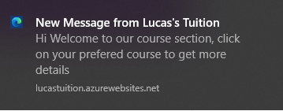
When the user first access the courses page, there will be a notification.

Slide 75
Demo

Slide 76
Conclusion

Slide 77
Conclusion
Implemented notifications, firebase, session storage, formbackend, PWA into our website.
Made a proper website with proper functionality and mobile responsive

